Slide 1
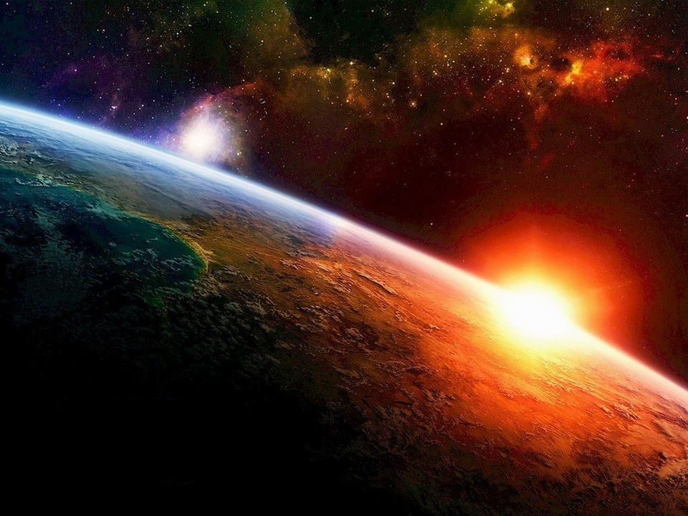
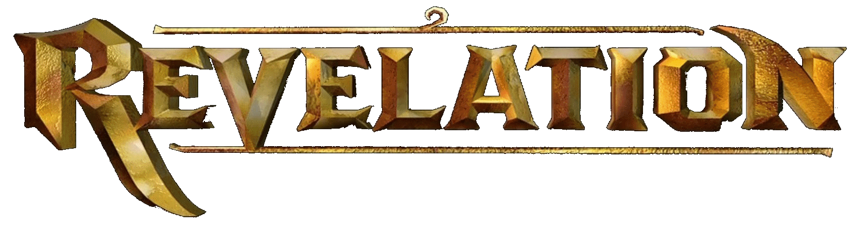

Slide 2
Revelation 21 – 22:2

Slide 3
Revelation 21:2
² And I John saw the holy city, new Jerusalem, coming down from God out of heaven . . .
Revelation NEVER says the “New Jerusalem” is coming to earth
Notes:
Pre-M claim “New Jerusalem” is coming down to earth … possibly for a 1000 Year Reign.
Some Pre-M claim that “New Jerusalem” will just orbit the earth.

Slide 4
Revelation 21:8
⁸ But the fearful, and unbelieving, and the abominable, and murderers, and sexually immoral, and sorcerers, and idolaters, and all liars, shall have their part in the lake which burns with fire and brimstone: which is the second death.
“fearful”
excessive fear of "losing” something ¹
Sorcerers – φάρμακος (pharmakos) ¹
poisoner, sorcerer, magician
“all liars”
every kind of or form of falsehood, deceit, lying, untruth ¹
¹ biblehub.com
Notes:
Sorcerers:
Cognate: Ref #5333 pharmakos (a poisoner, sorcerer, magician) – a sorcerer; refers to people using drugs and "religious incantations" (spells and charms) to drug people into living by their illusions as having magical, supernatural powers to manipulate God into giving them more temporal possessions.
This Greek word φάρμακος means in the Bible primarily a person who uses drugs and poisons to practice magic or sorcery.
51 translations (biblehub.com)
40 – sorcerers
6 – practice magic and magical incantations
2 – witchcraft
1 – charmers
1 – drug users
1 - poisoner
“all types of lies”

Slide 5
Revelation 21:21
²¹ And the twelve gates were twelve pearls; every several gate was of one pearl: and the street of the city was pure gold, as it were transparent glass.
“several”
apiece, respective, each ¹
NKJV – “individual” ¹
¹ biblehub.com

Slide 6
Revelation 21:23
²³ And the city had no need of the sun, neither of the moon, to shine in it: for the glory of God did lighten it, and the Lamb is the light [lamp] thereof.
ἐφώτισεν (ephōtisen ) - Ref #5461 ¹
1x in N.T. (other forms 11x)
Light up, illuminate, shine, light
λύχνος (luchnos ) - Ref #3088 ¹
6x in N.T.
Portable lamp usually set on a stand
¹ biblehub.com
Notes:
“There they need no sunshine bright
In that city four square
For the Lamb is all the light
And there is no night there.”
John 14:9-10
9 Jesus said to him, “Have I been with you so long, and yet you have not known Me, Philip? He who has seen Me has seen the Father; so how can you say, ‘Show us the Father’? 10 Do you not believe that I am in the Father, and the Father in Me? The words that I speak to you I do not speak on My own authority; but the Father who dwells in Me does the works.
Lamb holds that light
Lamb is a reflection of that light
But, Lamb is not the light

Slide 7

Revelation 21 - “New Jerusalem”
What Is the “New Jerusalem”?
Location of 1000 Year Reign (Premillennialism)
Jerusalem being rebuilt after its destruction
Heaven
Church

Slide 8
Revelation 21 - “New Jerusalem”
What Is the “New Jerusalem”?
Location of 1000 Year Reign (Premillennialism)
Jerusalem being rebuilt after its destruction
Heaven
Church

Slide 9
Revelation 21 - “New Jerusalem”
Location of 1000 Year Reign
1000 Year Reign already occurred (Ch. 20)
Satan already loosed from constraints (Ch. 20)
Satan already thrown into Lake of Fire (Ch. 20:10)
Ch. 21 – old earth and heaven (sky) are gone
Nothing unclean enters “New Jerusalem” (Ch. 21:27)
Pre-M - evil souls from “Hades” in 1000 Year Reign
Notes:
There are Pre-M who think:
Armageddon is the end of the world
1000 Year Reign will occur on earth
1000 Year Reign will occur in “New Jerusalem”
1000 Year Reign will occur on a new planet “discovered” by NASA a few years ago
Pre-M doctrine is all over the spectrum.
If nothing unclean will enter the “New Jerusalem”, then doctrine of 1000 year reign is wrong when it teaches evil will ascend from “hades” and join saints so that the saints may reign over them.

Slide 10
Revelation 21 - “New Jerusalem”
What Is the “New Jerusalem”?
Location of 1000 Year Reign (Premillennialism)
Jerusalem being rebuilt after its destruction
Heaven
Church

Slide 11
Revelation 21 - “New Jerusalem”
Jerusalem Rebuilt After Destruction
Judgment of evil already occurred in Ch. 20
Evil already thrown into the Lake of Fire (20:10)
“old earth and heaven have passed away” (21:1)
Post-judgment day
Physical is gone – all spiritual
No where to build another Jerusalem
Nothing unclean enters “New Jerusalem”
Jews cannot live there
Notes:
Ch. 20 tells us where evil will spend their eternity
Ch. 21 tells us where the bride of the Lamb will spend her eternity

Slide 12
Revelation 21 - “New Jerusalem”
What Is the “New Jerusalem”?
Location of 1000 Year Reign (Premillennialism)
Jerusalem being rebuilt after its destruction
Heaven
Church

Slide 13
Revelation 21: “New Jerusalem” Identity
How did we determine:
Meaning of the Tribulation?
7 Kings + 1
Identity of the villain in Revelation?
Meaning and purpose of scroll with 7 seals?
Use lists of characteristics (Revelation or history)
How determine meaning of “New Jerusalem”?
Same way
Notes:
Tribulation: chapters 1,6,7,20 (The “Forbidden Zone”)
Villain ID: characteristics of villain throughout ”Forbidden Zone”
7 Kings + 1: Tribulation + Villain ID + history of 1st century church
Scroll: historical references to scrolls and seals + see how used in “Forbidden Zone”
Let Revelation tell you what it wants you to know

Slide 14
Revelation 21: “New Jerusalem” Identity
New heaven, new earth; 1st are gone (spiritual)
Descending from sky, not on earth (spiritual)
“as” a bride/wife adorned for husband (Lamb)
High walls
12 gates (tribe’s name above each)
12 foundations (apostle’s name on each)
Angel measures the city
Gates made of pearl
Street of pure gold
Nothing defiled enter or live there
Inhabitants names are in book of life
“New Jerusalem” = Heaven
Notes:
Structure is Heaven
Inhabitants of the city are the church
Sometimes a city name is used to represent the inhabitants
Matt 23:37 (NKJV) “O Jerusalem, Jerusalem, the one who kills the prophets and stones those who are sent to her! How often I wanted to gather your children together, as a hen gathers her chicks under her wings, but you were not willing!

Slide 15
Revelation - A Colorful Book
Revelation 9:17 (NKJV)
¹⁷ And thus I saw the horses in the vision: those who sat on them had breastplates of fiery red, hyacinth blue, and sulfur yellow; and the heads of the horses were like the heads of lions; and out of their mouths came fire, smoke, and brimstone.

Slide 16
Revelation 21:19-21
Revelation 21:19-20 (KJV)
¹⁹ And the foundations of the wall of the city were garnished with all manner of precious stones. The first foundation was jasper; the second, sapphire; the third, a chalcedony; the fourth, an emerald;
²⁰ The fifth, sardonyx; the sixth, sardius; the seventh, chrysolite; the eighth, beryl; the ninth, a topaz; the tenth, a chrysoprasus; the eleventh, a jacinth; the twelfth, an amethyst.
Notes:
Revelation relies upon color to portray its message
Chalcedony - kal·seh·duh·nee Sardonyx - saar·daa·nuhks Chrysolite - kri·suh·lite
Chrysoprasus – Chry – so’ - prasus

Slide 17
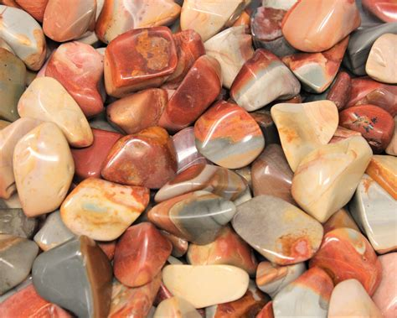
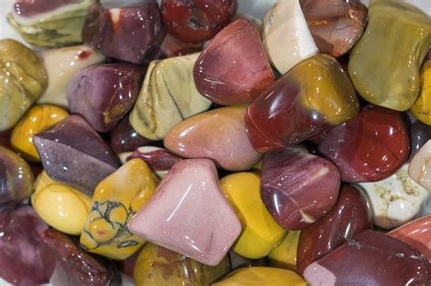
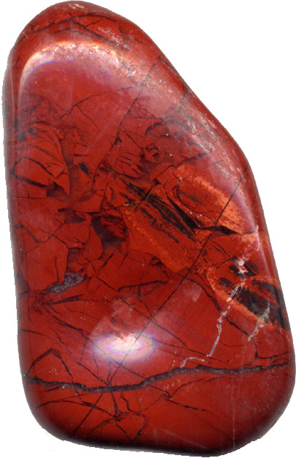
1. Jasper
Notes:
Various colors.

Slide 18
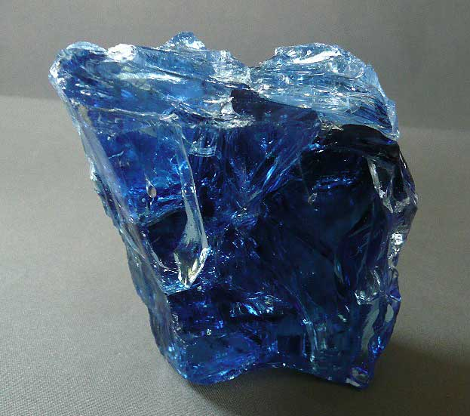
2. Sapphire

Slide 19
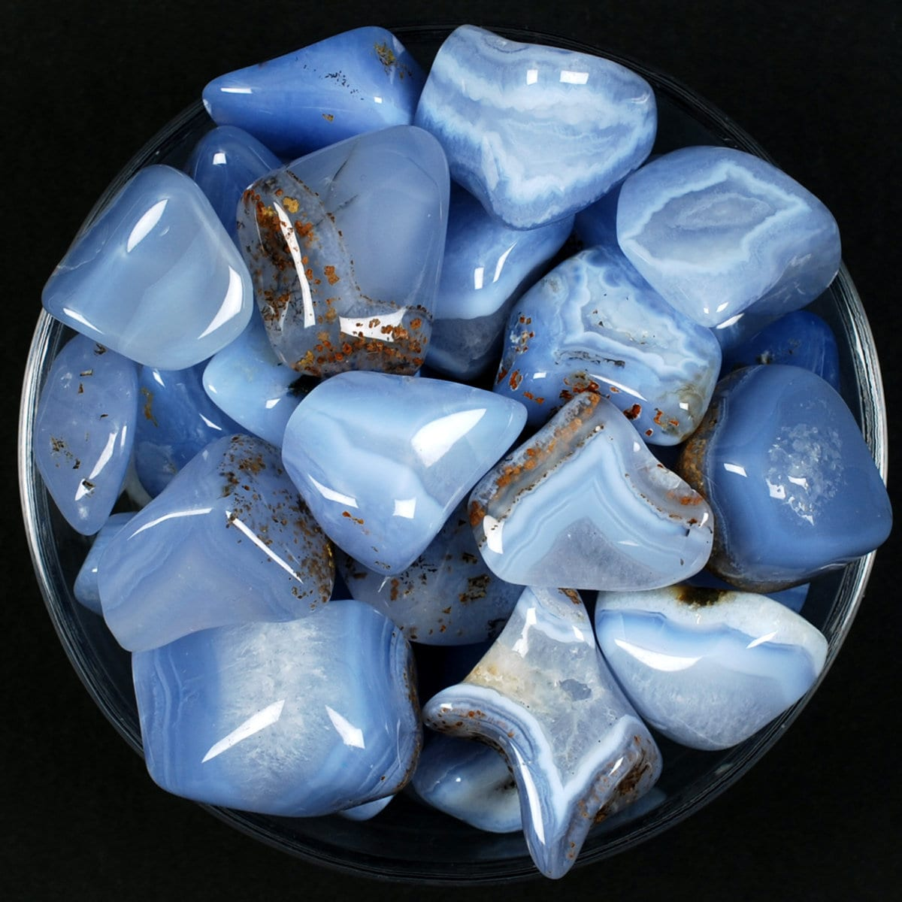
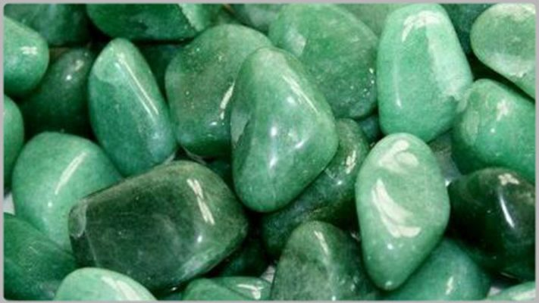
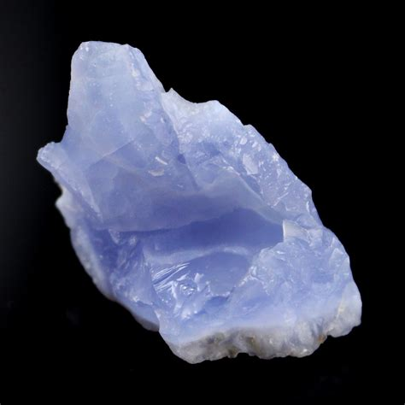
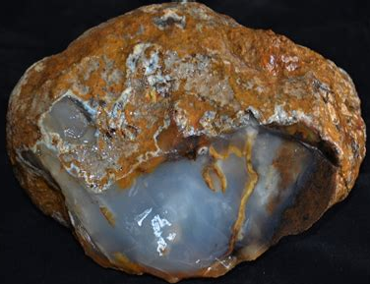
3. Chalcedony
Notes:
Chalcedony - kal·seh’·duhnee

Slide 20
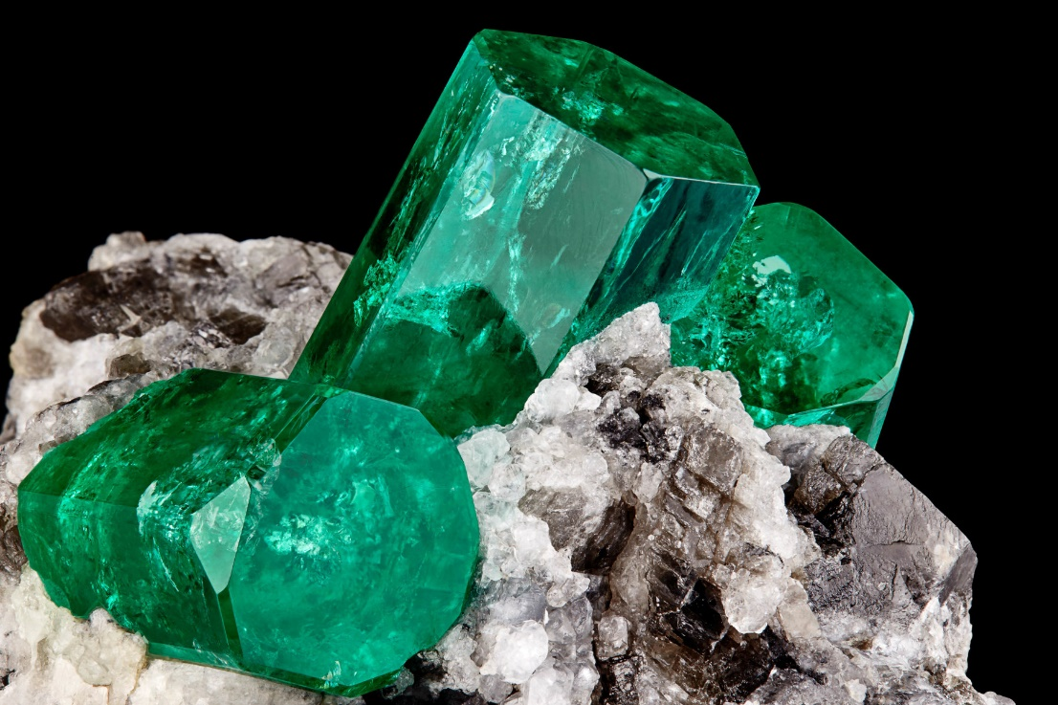
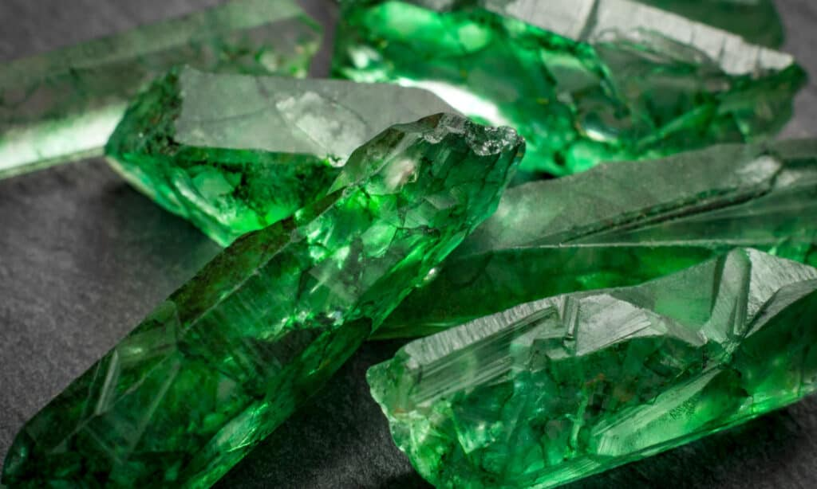
4. Emerald

Slide 21
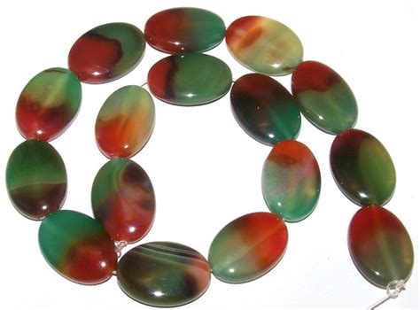
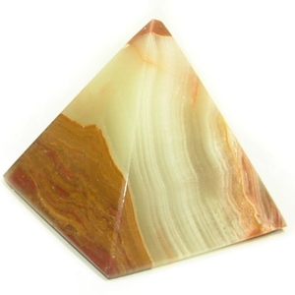
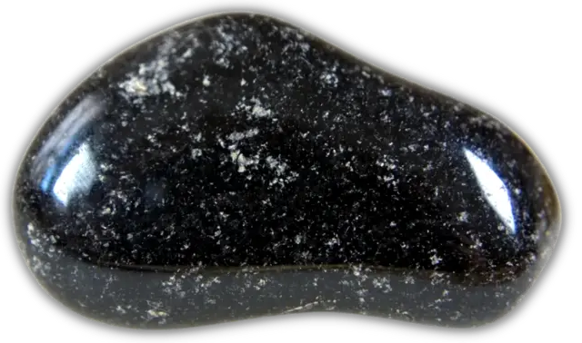
5. Sardonyx
Notes:
Type of onyx

Slide 22
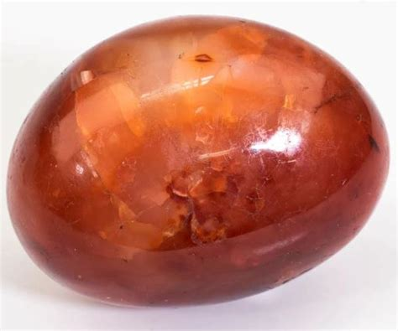
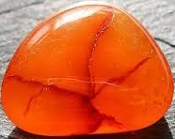
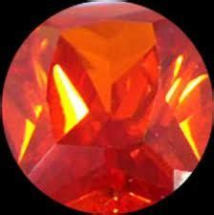
6. Sardius

Slide 23
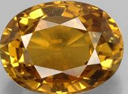
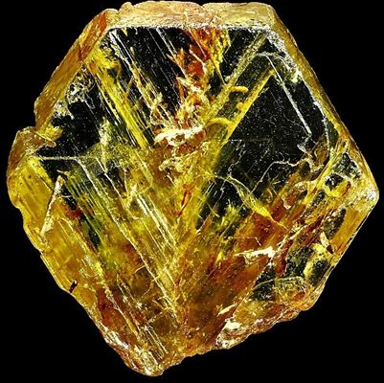
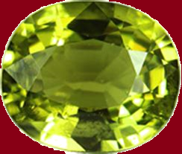
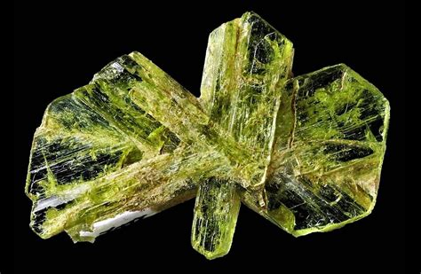
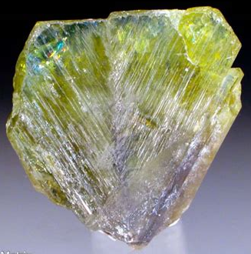
7. Chrysolite
Notes:
chrysolite a.k.a. chrysoberyl
Type of quartz

Slide 24
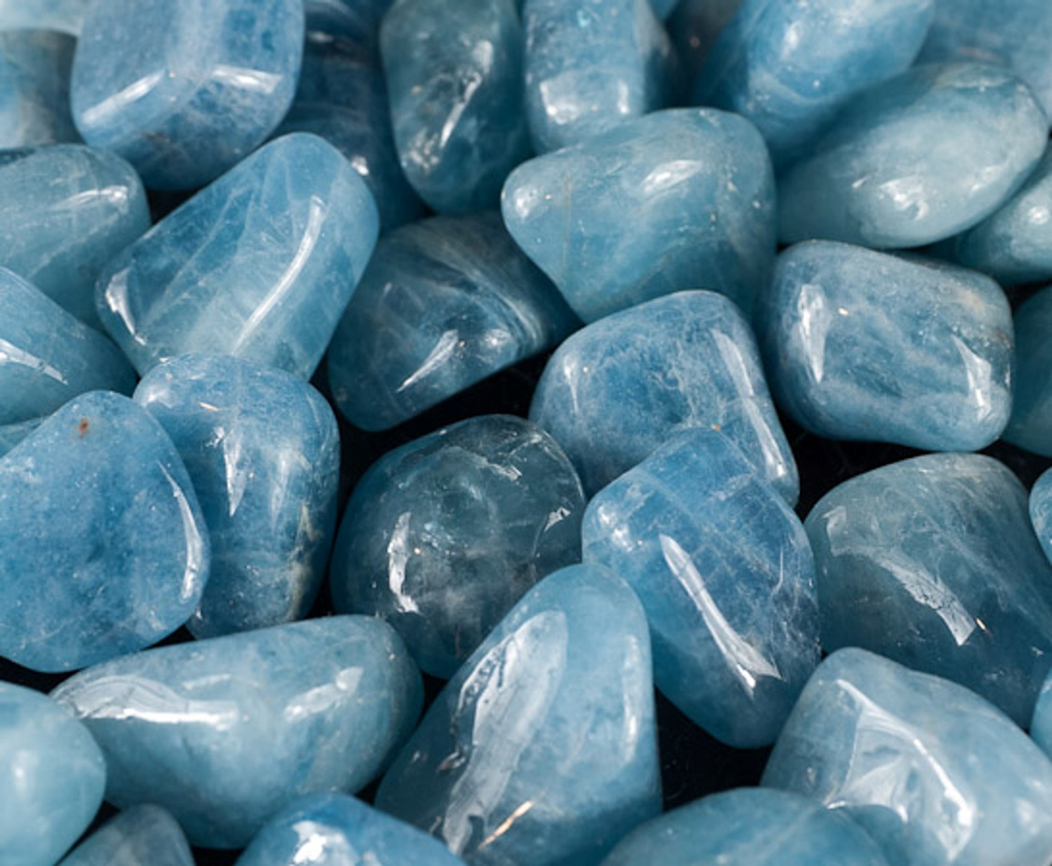
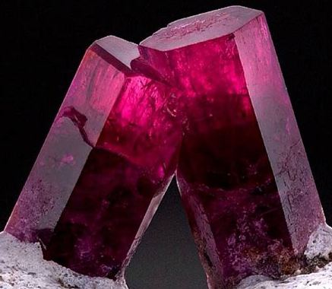
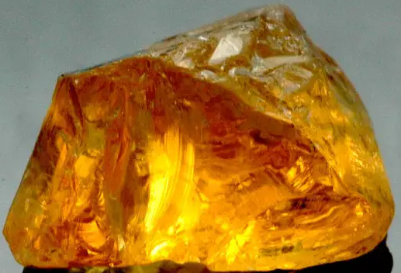
8. Beryl

Slide 25
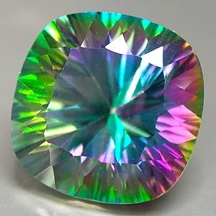
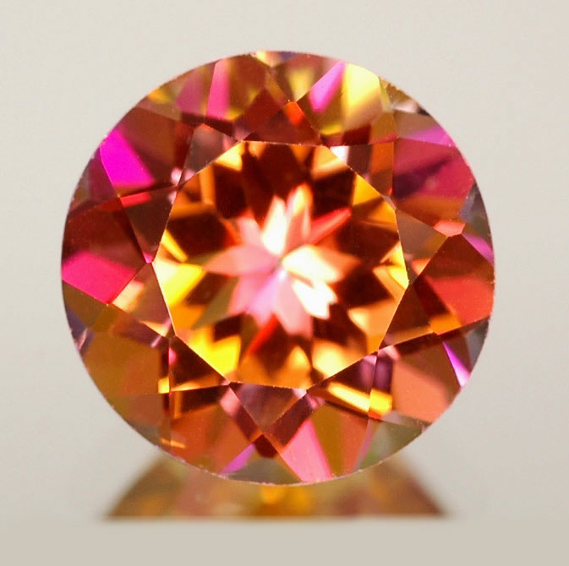
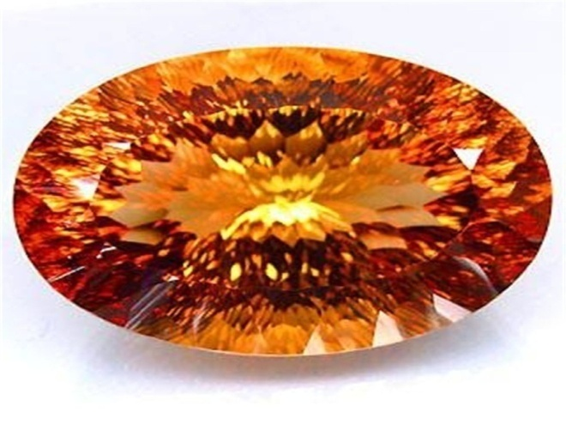
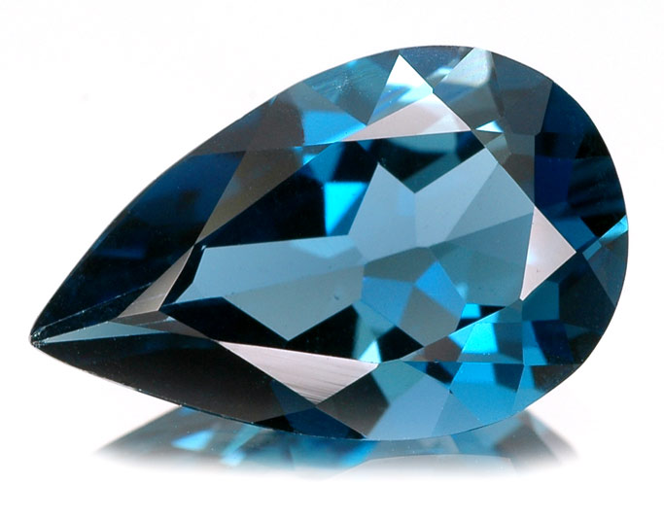
9. Topaz
Notes:
Popular star-burst patterns

Slide 26
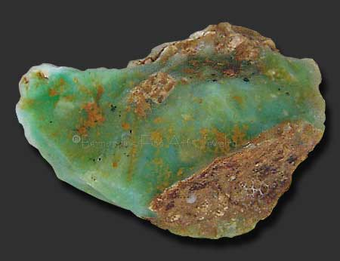
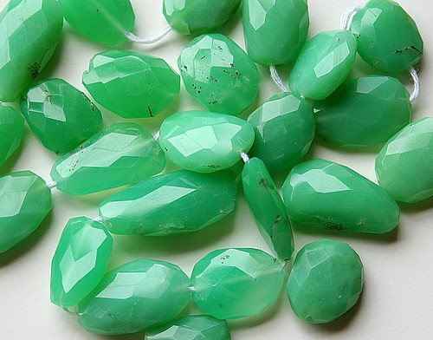
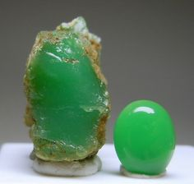
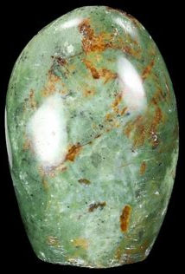
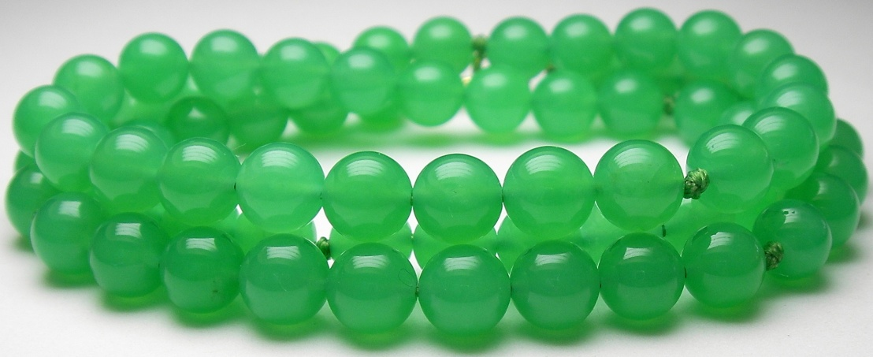
10. Chrysoprasus
Notes:
Chrysoprasus – Chry – so’ – prasus

Slide 27
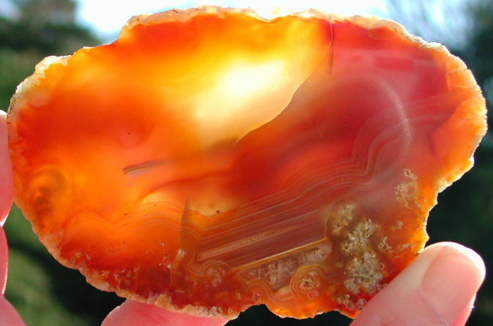
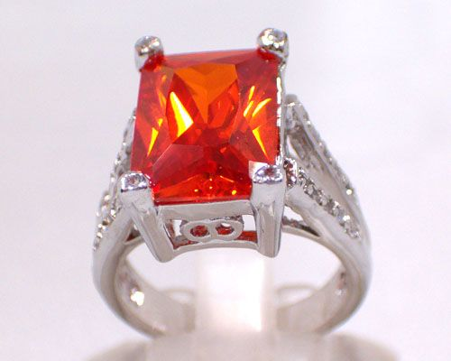
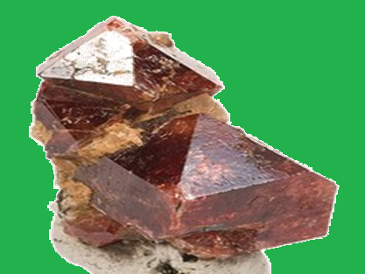
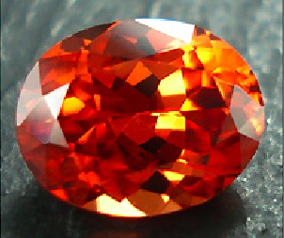
11. Jacinth

Slide 28
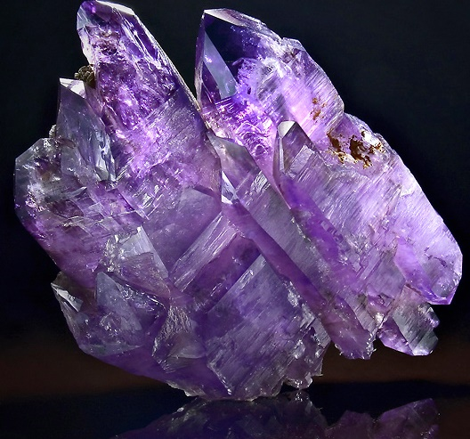
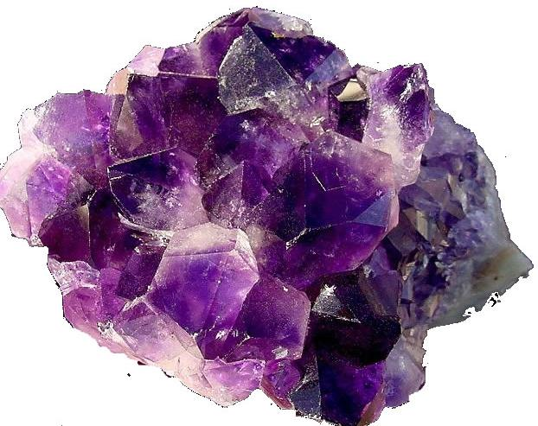
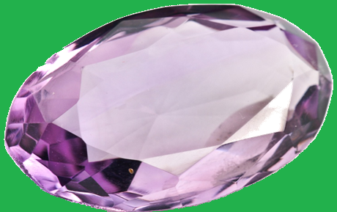
12. Amethyst

Slide 29
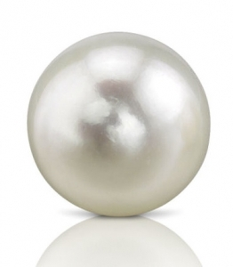


Gates: Pearl

Slide 30
Revelation 22:18-19
¹⁸ For I testify unto every man that heareth the words of the prophecy of this book, If any man shall add unto these things, God shall add unto him the plagues that are written in this book:
¹⁹ And if any man shall take away from the words of the book of this prophecy, God shall take away his part out of the book of life, and out of the holy city, and from the things which are written in this book.
“tree of life”
“book of life”
“scroll of life”
“life-giving tree”
- 28x ¹
- 15x ¹
- 2x ¹
- 1x ¹
"something you eat from" vs. "something your name is written in"?
¹ biblehub.com
Notes:
===========================================
28 "tree of life"
American Standard Version
Amplified Bible
Anderson New Testament
Aramaic Bible in Plain English
Berean Literal Bible
Berean Study Bible
Christian Standard Bible
Darby Bible Translation
English Revised Version
English Standard Version
GOD'S WORD® Translation
Godbey New Testament
Good News Translation
Holman Christian Standard Bible
International Standard Version
Lamsa Bible
Literal Emphasis Translation
Mace New Testament
NASB 1977
NASB 1995
New American Standard Bible
New Heart English Bible
New International Version
New Living Translation
Weymouth New Testament
World English Bible
Worrell New Testament
===========================================
2 "scroll of life"
Literal Standard Version
Young's Literal Translation
1 "life-giving tree"
Contemporary English Version
===========================================
15 "book of life"
A Faithful Version
American King James Version
Bishops' Bible of 1568
Catholic Public Domain Version
Coverdale Bible of 1535
Douay-Rheims Bible
Geneva Bible of 1587
Haweis New Testament
King James 2000 Bible
King James Bible
New King James Version
Smith's Literal Translation
Tyndale Bible of 1526
Webster's Bible Translation
Worsley New Testament
===========================================
For translations who are trying to equate these two items, how do you reconcile "something you eat from" with "something your name is written in"?

Slide 31
Revelation 22:18-19
¹⁸ For I testify unto every man that heareth the words of the prophecy of this book, If any man shall add unto these things, God shall add unto him the plagues that are written in this book:
¹⁹ And if any man shall take away from the words of the book of this prophecy, God shall take away his part out of the book of life, and out of the holy city, and from the things which are written in this book.
ξύλον (xylon) - Ref #3586 ¹
5x in N.T.
(3x in Rev: 18:12 , 22:2 , 22:14)
anything made of wood, a club, staff, trunk of tree,
used to support the cross-bar of a cross in crucifixion ¹
(definition never includes “book”)
¹ biblehub.com
Notes:
1 Peter 2:24 (NKJV) who Himself bore our sins in His own body on the tree, that we, having died to sins, might live for righteousness—by whose stripes you were healed.
In 1st century, “books” were still made from the papyrus plant. (scrolls)
“Tree of Life” – sustained Adam and Eve. Used symbolically in Rev. as sustaining the saved.

